Slide 1
Evolutionary Algorithms
Decision analytics

Slide 2
Evolutionary Algorithms
A technique of heuristic mathematical optimization based on Darwin’s Theory of Evolution.
Can be used on any spreadsheet model, including those with “If” and/or “Lookup” functions.
Also known as Genetic Algorithms (GAs).

Slide 3
Evolutionary Algorithms
Solutions to a mathematical programming problem can be represented as a vector of numbers (like a chromosome)
Each chromosome has an associated “fitness” (obj) value
GAs start with a random population of chromosomes & apply
Crossover - exchange of values between solution vectors
Mutation - random replacement of values in a solution vector
The most fit chromosomes survive to the next generation, and the process is repeated

Slide 4
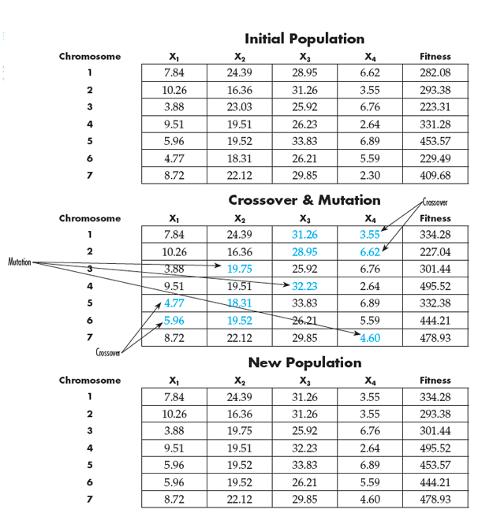
Example of iteration

Slide 5
Example: Forming Fair teams
The director of an MBA program wants to form project teams for the incoming class of students. There are 34 students and he wants to create 7 teams so that the average GMAT score for each team is as similar as possible.

Slide 6
Example: Traveling salesperson
A salesperson wants to find the least costly route for visiting clients in n different cities, visiting each city exactly once before returning home.
n (n-1)!
3 2
5 24
9 40,320
13 479,001,600
17 20,922,789,888,000
20 121,645,100,408,832,000

Slide 7
Example: Traveling salesperson
Wolverine Manufacturing needs to determine the shortest tour for a drill bit to drill 9 holes in a fiberglass panel.

Slide 8
Machine-sequencing problem Miles manufacturing Co.
Job Number | 1 | 2 | 3 | 4 | 5 | 6
Processing time (hours) | 5 | 7 | 9 | 11 | 13 | 15
Due date (hours from now) | 28 | 35 | 24 | 32 | 30 | 40
How should the jobs be scheduled so tardiness is minimized?
How should the jobs be scheduled so the maximum tardiness is minimized?

Slide 9
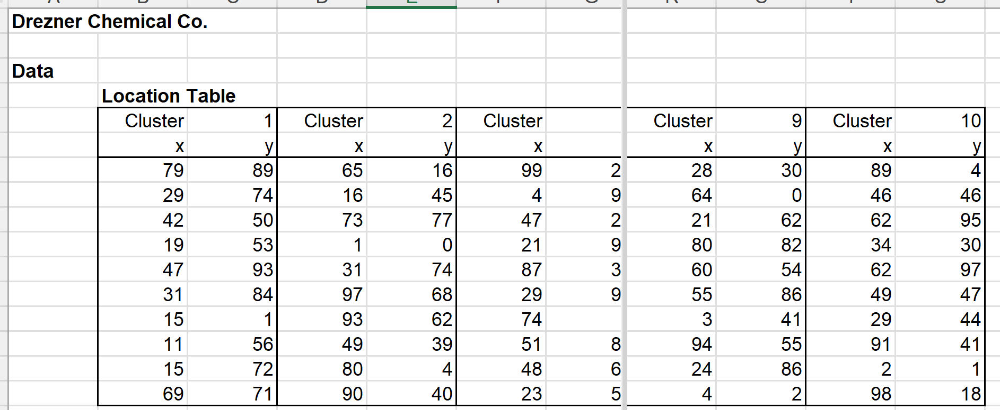
Drezner chemical co. Location of new production plant

